Slide 1


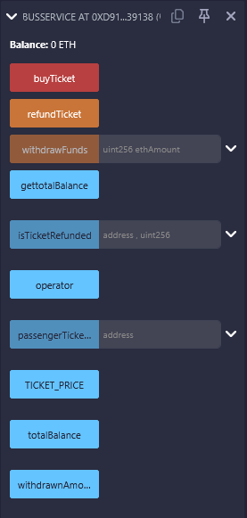
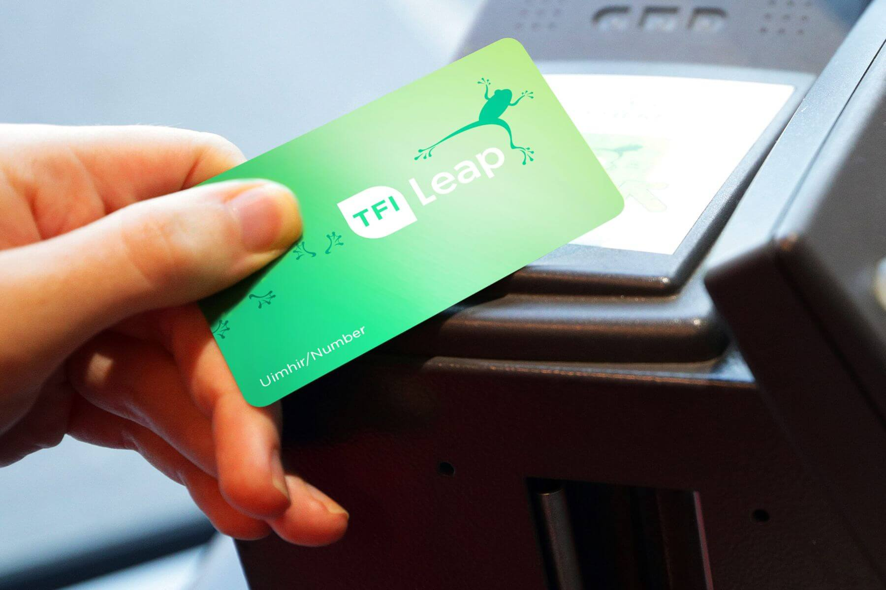
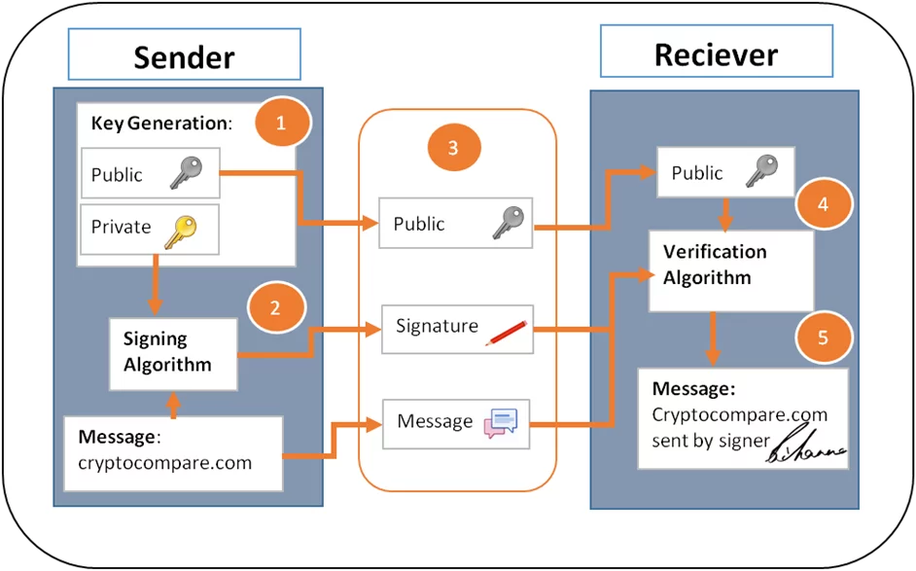

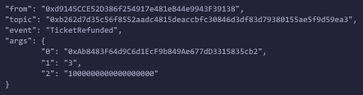
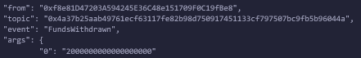
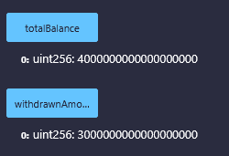

Bus Ride - CA1
Students: Telmuun Dunia Lecturer: Muhammad Iqbal
GitHub repository: https://github.com/CCT-Dublin/ca1-40-TelmuunDn
Video link: https://drive.google.com/file/d/1WnljC_cyI13mNB7KxtaYeuWBBao2kZQh/view?usp=sharing
Project Overview
Ireland’s Bus Payment System
Ireland’s public transport system including Dublin Bus, Bus Éireann, Luas, and Irish Rail uses a centralized smart card system called the Leap Card. Passengers buy physical Leap Cards, top up funds (in euros), and each card’s balance and transaction history are stored in a centralized database managed by the National Transport Authority (NTA). Ticket validators read and deduct fares during boarding.
BLOCKCHAIN BASED TICKETING SYSTEM
Cryptographic Security (ECC & Ethereum)
Ticket Purchase
Passengers purchase tickets by sending ETH equal to the fixed ticket price. The smart contract:
Records the passenger’s ticket count
Generates a ticket ID
Emits an on-chain event for transparency
Refunds any excess ETH sent
The system uses Ethereum’s built-in Elliptic Curve Cryptography (secp256k1). Every wallet involved uses ECC-based key pairs and ECDSA signatures. This provides:
Secure authentication of all transactions
Protection from tampering or unauthorized purchases
Strong cryptographic guarantees without requiring additional code in the contract
Key Issues with the Current System.
Centralized control by the NTA with limited transparency.
High maintenance costs for card infrastructure and servers.
Fraud and tampering with balances or counterfeit cards.
Limited interoperability with other EU transport systems.
Slow settlement of funds between operators and authorities.
Ticket Refund
Passengers may refund their most recent unused ticket. The contract prevents double refunds and ensures only valid tickets can be refunded. Refunded tickets are permanently marked on-chain to ensure integrity.
Proposed Blockchain-Based Ticketing System
Instead of complex multi-operator revenue distribution or tokenized euros, this smart contract implements:
Buying tickets using ETH
Recording ticket IDs
Issuing refunds for unused tickets
Allowing the operator to withdraw accumulated funds
Transparent and tamper-proof transaction history
The Smart Contract features
in the Solidity contract:
Fixed-price ticket purchasing (1ETH per ticket for demonstration purposes)
Contract-level revenue tracking
Refund system for unused tickets
Operator-restricted fund withdrawal
Transparency via blockchain events
Operator Withdrawals
Only the designated operator address can withdraw funds collected from ticket purchases. This reflects the real-world role of Transport for Ireland or an authorized bus operator managing fare revenue.
Conclusion
Benefits of This Blockchain Model
Decentralization of passenger payments.
Transparency of all ticket purchases and refunds.
Prevention of refund fraud due to immutable state.
Reduced reliance on centralized servers.
Simple and deployable proof‑of‑concept architecture.
Challenges and Limitations
Uses ETH instead of Euro fares.
No distance-based or zone-based fare calculation logic.
Does not support multiple transport operators.
No integration with bus validators or scanning devices.
Passengers are identified only by Ethereum wallet addresses.
It forms a simple, secure, and transparent alternative to centralized fare systems like Ireland’s Leap Card. Future upgrades may include tokenized currency, fare calculation logic, decentralized identity, validator integration, and multi-operator settlement mechanisms.
Total Balance, and Previously withdrawn amount
This can show the total amount withdrawn from the balance of payments from passengers, and Total Balance reflect the addition of both the Current Balance + Withdrawn Amount = Total Balance.
https://remix.ethereum.org https://codingwithsaleem.medium.com/ethereums-elliptic-curve-digital-signature-algorithm-ecdsa-88e1659f4879
REFERENCES

